Slide 1


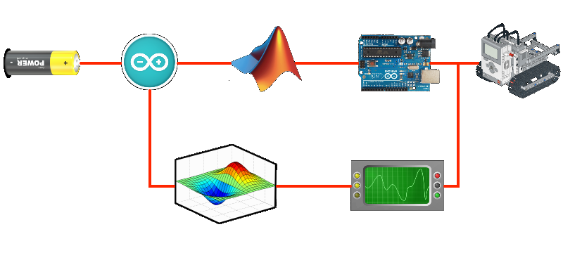
Matlab (Semulink - arduino) And Altium
Programming using blocks

Slide 2







TEAM
UNDER SUPERVISION:
Muhammed Ibrahim
Abdul Rahman Al Hussein
Abdullah Ashraf
Dr.Eltaib Abdeen
Ziad Emad
Muhammed Aboalhsan

Slide 3




Smulink Arduino

Slide 4
Contents Chapter One: Introduction to Simulink and Arduino........................ 1- What is Semilink ................................................ ...................... 2- What is Arduino?............................................ .......................... Chapter Two: Introduction is Altium............................................. .. 1- What is Altium 2- Example to project Chapter Three: Beginning Work............................................. .. 1- Tools used in designing the cupper bord? 2- Components used in the circuit:
Smulink Arduino

Slide 5
Smulink Arduino
Chapter One
Introduction to Semilink with Arduino

Slide 6
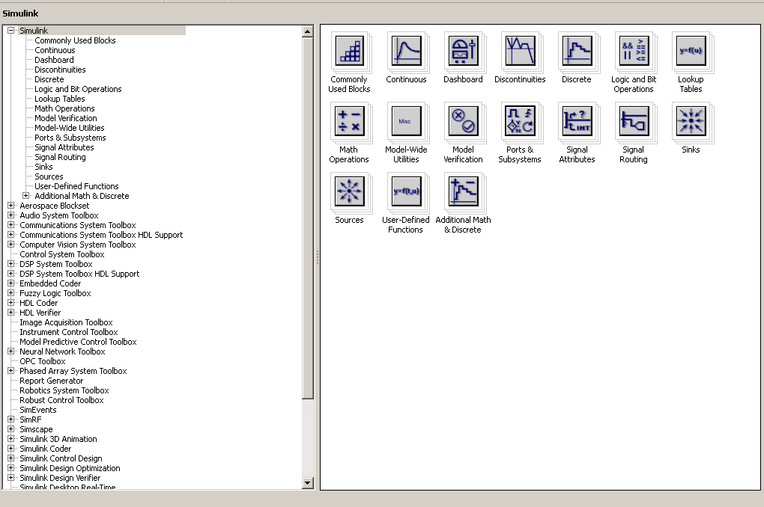
Smulink Arduino
What is Semilink:
-A programming language for simulating dynamic systems, whether linear or nonlinear
It relies on writing programs on blocks (boxes).
-t contains semuolink It contains a library of blocks covering most electrical and mechanical engineering applications.

Slide 7

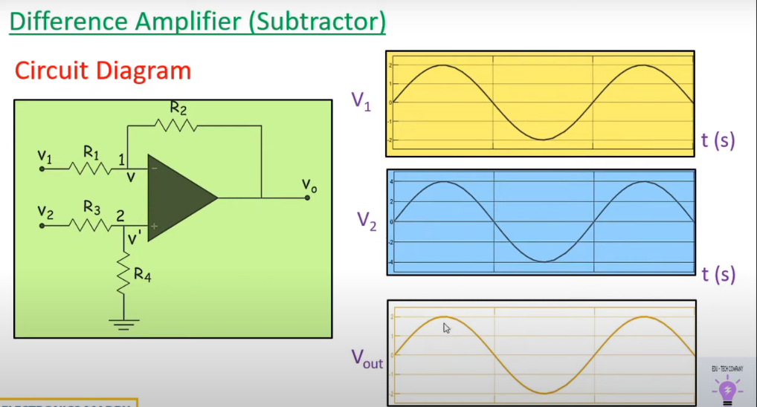
Smulink Arduino
Example in electrical engineering:
Difference between two input in op-amp circuit

Slide 8
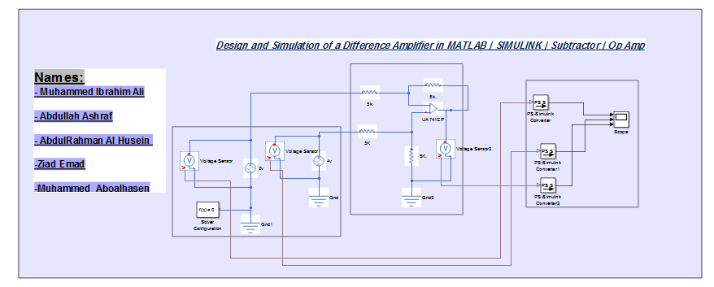
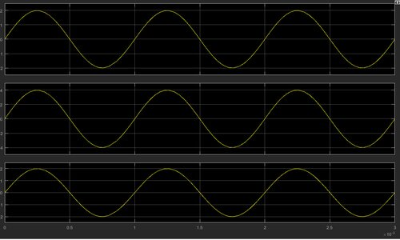
Smulink Arduino

Slide 9
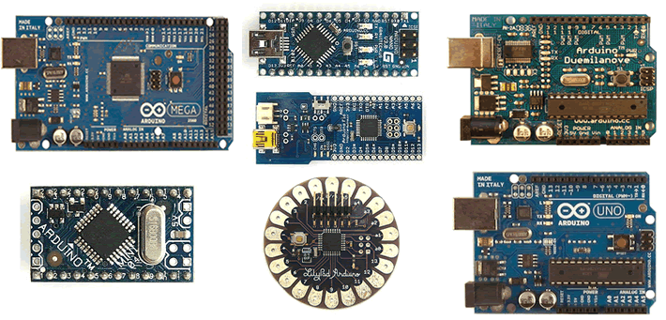
Smulink Arduino
What is Arduino:
It is an electronic board with different versions and types And a midwife
For programming using the computer to implement electronic projects in various fields
(Control, communications, measurements, .........).
وهذا الرابط لن اراد أن يتعرف اكثر على مواصفات ومميزات كل نوع من
لوحات الردوينو.
http://arduino.cc/en/main/boards

Slide 10
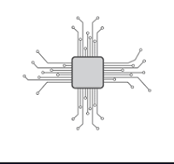

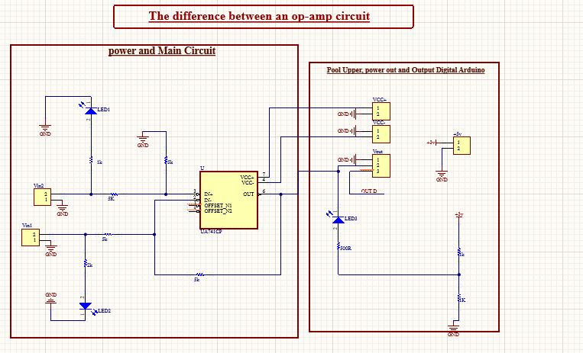
Scimatic and PCB Design
Schematic file:
-It represents the basic diagram of an electrical circuit, where components are drawn and connected to show how the circuit works.
-Altium Designer provides advanced tools to draw these diagrams easily and accurately, with updated component libraries to speed up the process.
Example to project:

Slide 11
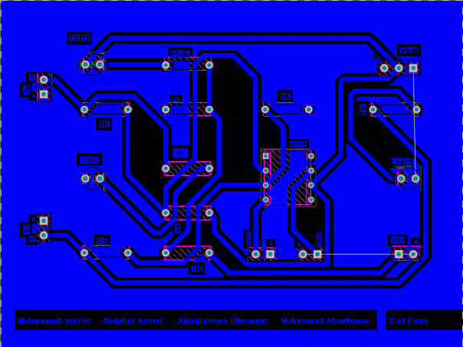
Scimatic and PCB Design
PCB file:
-Represents the actual board layout, including the location of components and the communication paths between them.
-Altium Designer supports multi-layer design, and includes a 3D rendering feature for the design.
-With Altium Designer, electronics designers can move seamlessly from drawing diagrams to designing boards, making it easier to develop integrated, efficient projects.

Slide 12
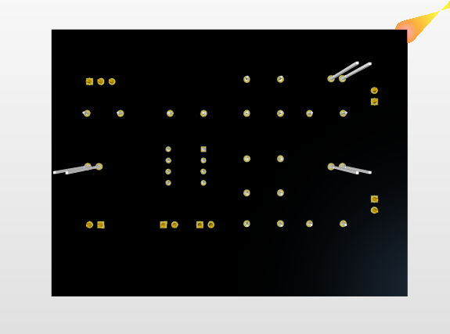
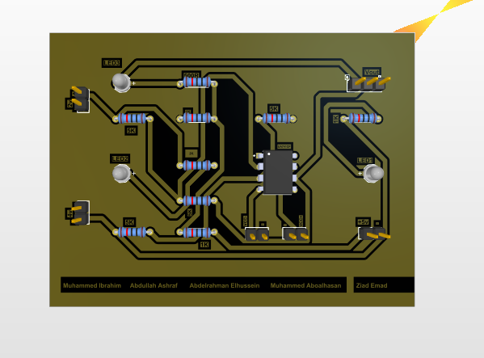
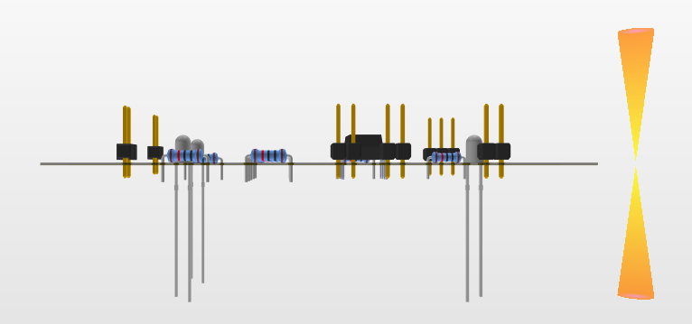
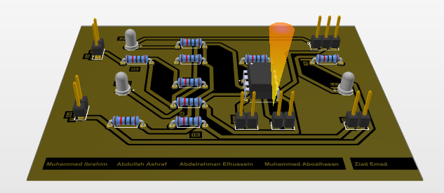
Scimatic and PCB Design
3D File in Altium:
TOP Side
Bottom Side
Back Side
Front Side

Slide 13
Scimatic and PCB Design
Chapter Three
Beginning Work

Slide 14
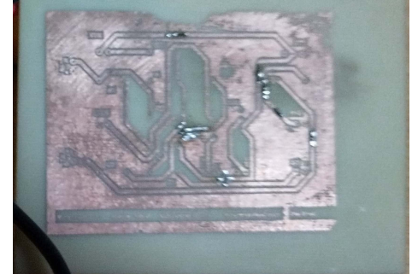
Scimatic and PCB Design
Tools used in designing the cupper bord:
1- Glossy paper.
2-Iron chloride acid (FECL3).
3-Acetone or Iron (مكوى).
4-Cupper bord.
5-Punta
Components used in the circuit:
1) 5 headers 2*1
1 header 3*1
2) 4 Resistors it’s value 5k ohm, 3 Resistors it’s value 1k ohm
1 Resistor it’s value 2k ohm , 1 Resistors it’s value 500 ohm
3) 1 UA741CP OP-AMP (DIP8). ,4) 3 LED (1.5 : 3 V)

Slide 15
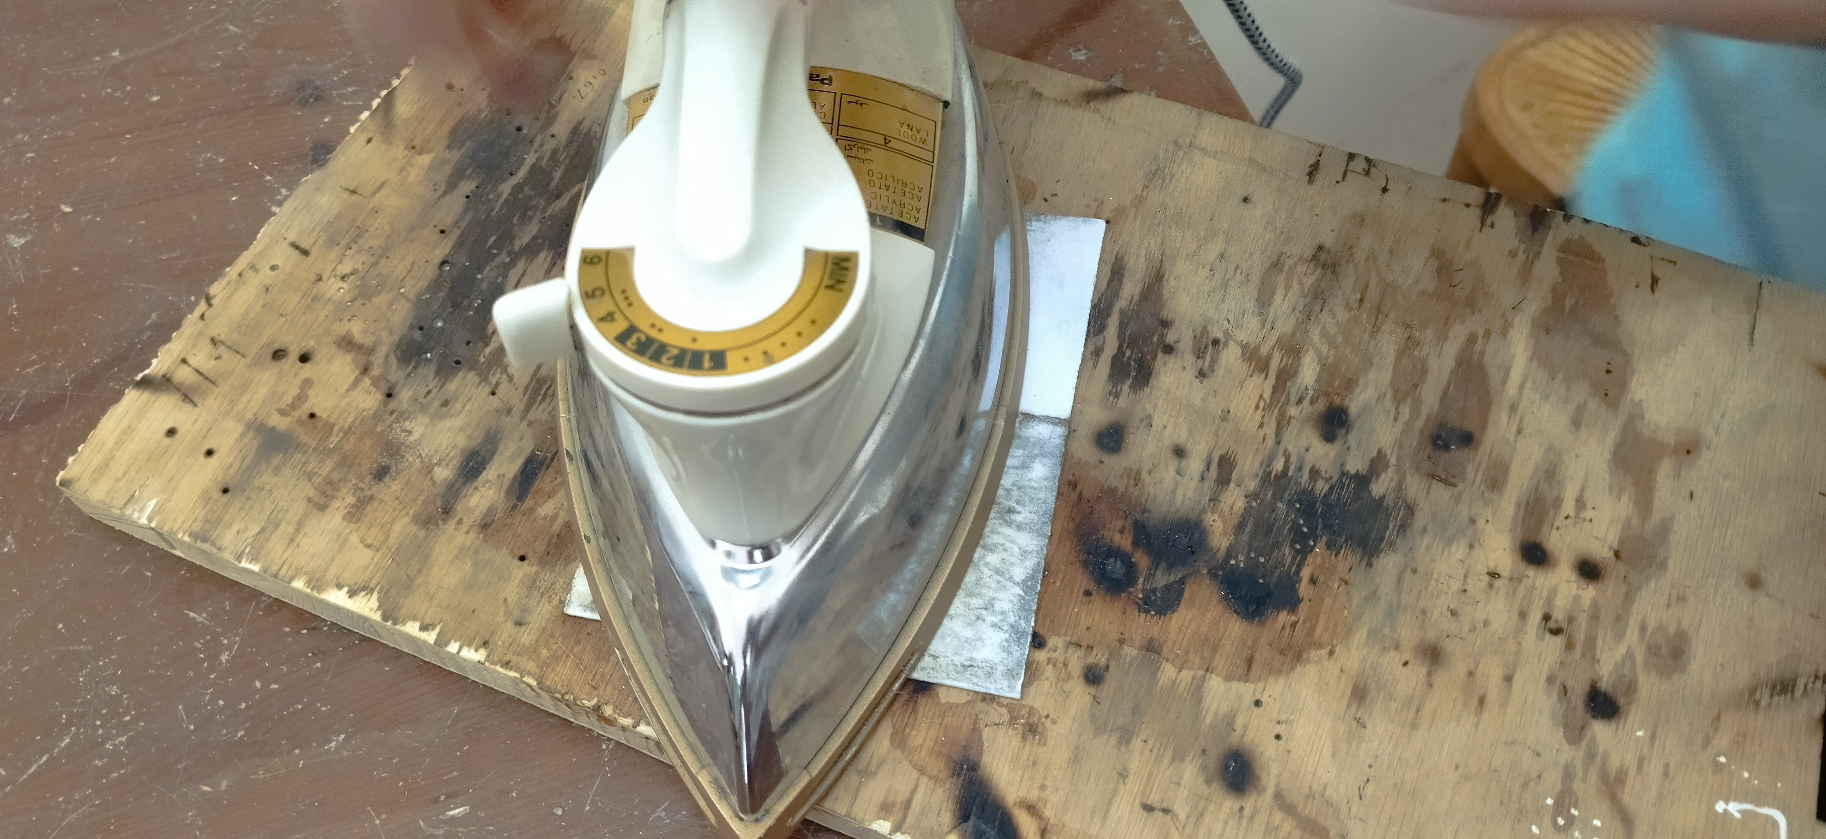
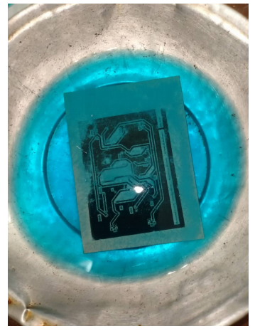
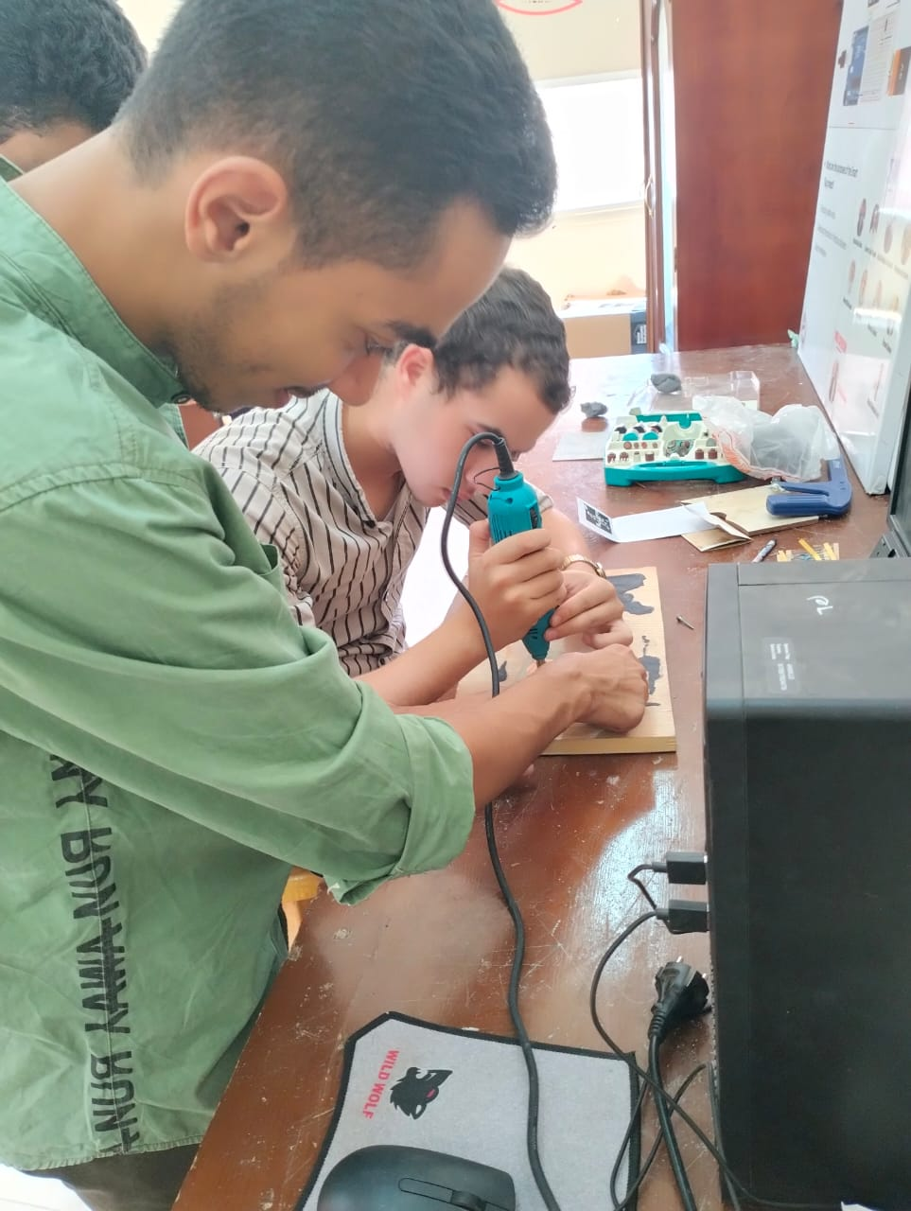
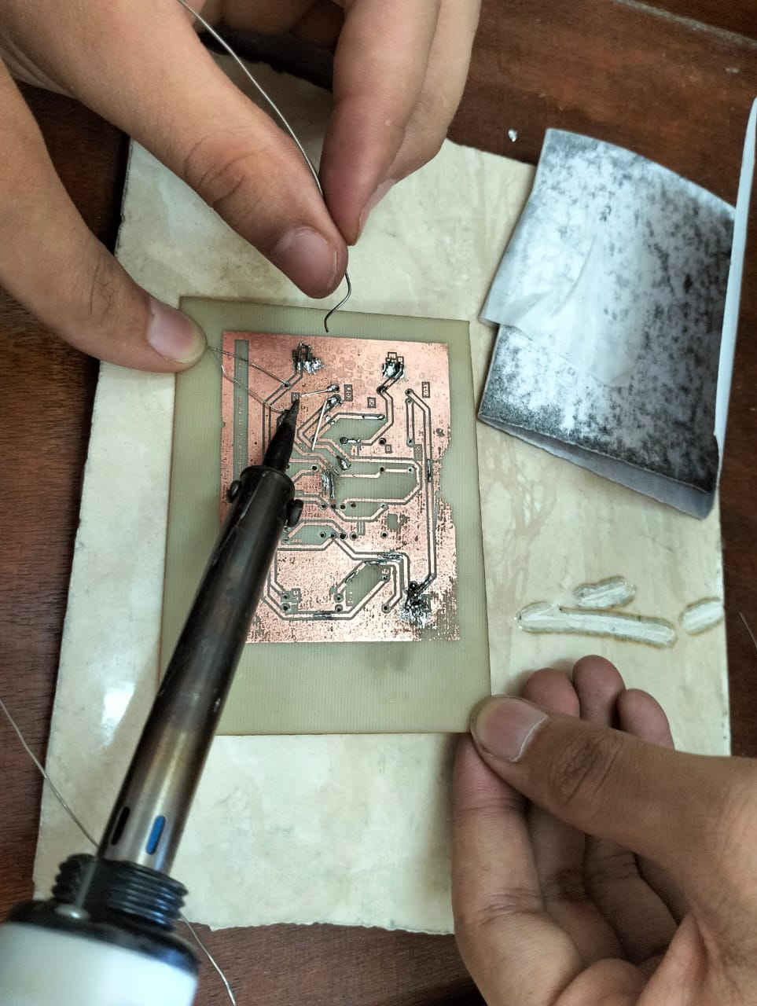
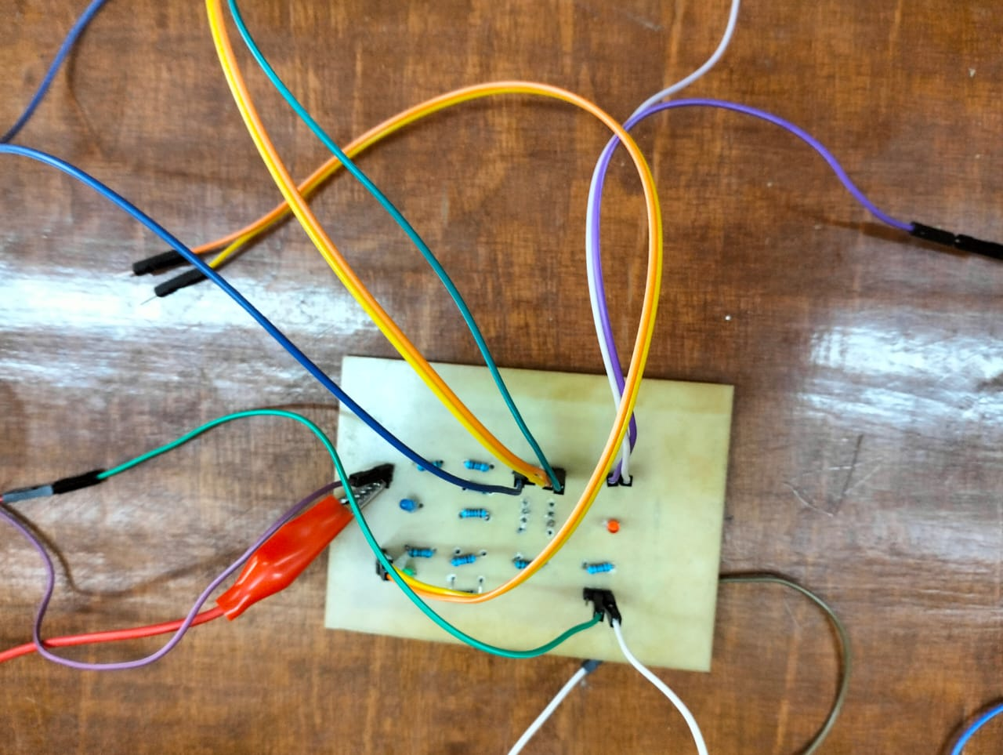
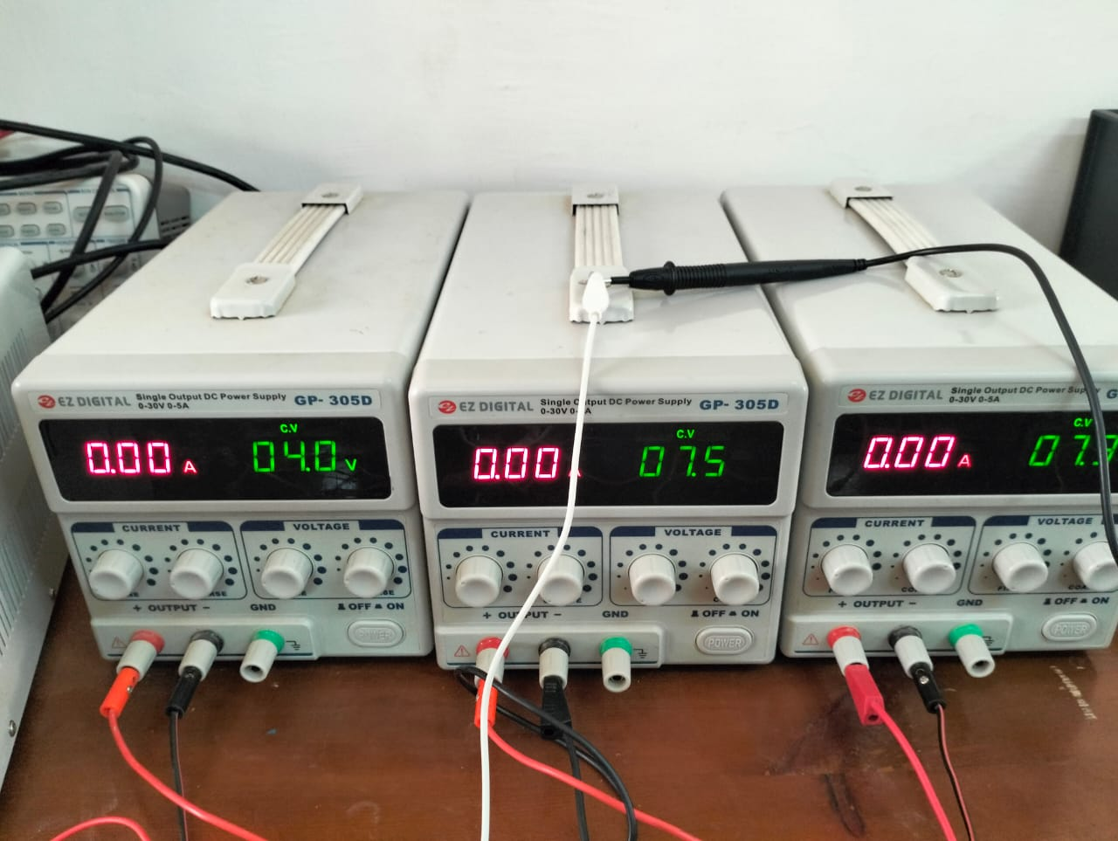
Scimatic and PCB Design
Some pictures of the working steps:
1-Ink print on bord
(طباعة الحبر على البردة)
2-Putting the chalazion inside acid
(وضع البردة داخل الحمض)
3-Open chalazion holes
(فتح ثقوب البردة)
4-Installing and soldering components
(تركيب المكونات ولحامها)
5-Conneccting the circuit
( توصيل الدائرة)
6-Circuit test
(اختبار الدائرة)

Slide 16


